Slide 1
FAKULTAS TEKNOLOGI INFORMASI
KECERDASAN TIRUAN
[ KP045/ 3 SKS ]

Slide 2
Pencarian Heuristic (Informed Search)
Pertemuan 4

Slide 3
Tujuan Pembelajaran
Mahasiswa dapat memahami konsep pencarian atau problem solving sebagai salah satu konsep dasar Artificial Intelligence (AI)
Mahasiswa dapat memahami konsep problem solving
Mahasiswa dapat memahami jenis-jenis teknik pencarian (blind & heuristic)

Slide 4
Topik Pembahasan
Pengantar
Uniform Cost Search
Pencarian Heuristik dan Contoh Algoritmanya
Greedy Best First Search
A*
Latihan Mandiri

Slide 5
PENGANTAR
Pencarian buta (uninformed/blind search):
Breadth First Search (BFS)
Depth First Search (DFS)
Iterative Deepening Search
Uniform Cost Search
Apa kelemahan dari blind search ?

Slide 6
PENGANTAR
Kelemahan blind search:
Waktu akses lama
Memori yang dibutuhkan besar
Ruang masalah besar – tidak cocok – karena keterbasan kecepatan komputer dan memori
Solusi: heuristic search / informed search.

Slide 7
HEURISTIC SEARCH
Pencarian heuristik – menggunakan suatu fungsi yang menghitung biaya perkiraan / estimasi dari suatu simpul tertentu menuju ke simpul tujuan (disebut fungsi heuristik) – h(n)
Algoritma pencarian heuristik (informed search):
Generate and Test (GT) algorithm
Best First Search (BFS) algorithm: Greedy BFS, A*
Hill Climbing (HC) algorithm: Simple HC, Steepest-Ascent HC

Slide 8
INGAT KEMBALI: PENYELESAIAN MASALAH
Mendefinisikan masalah dengan tepat.
Pendefinisian ini mencakup spesifikasi yang tepat mengenai keadaan awal dan solusi yang diharapkan.
Masalah dapat didefinisikan secara formal dengan 5 komponen berikut :
Initial state (keadaan awal)
Action description (deskripsi aksi)
Transition model (model transisi)
Goal test (uji solusi)
Path cost (kompensasi jalur)

Slide 9
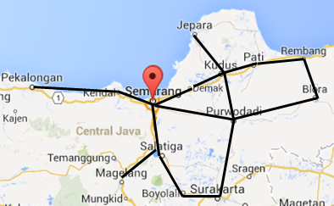
CONTOH PENDEFINISIAN RUANG MASALAH
Initial State, state sekarang (s) : In(Semarang)
Action Description (a) : {Go(Demak), Go(Kendal), Go(Salatiga, Go(Purwodadi)}
Transition Model : RESULT(s,a) = RESULT(In(Semarang), Go(Kendal)) = In(Kendal)
Goal Test, misal tujuan adalah Surakarta maka goal adalah {In(Surakarta)}
Path Cost, misal menggunakan jarak, Semarang ke Purwodadi adalah 65km, maka c(s,a,s’) = c(In(Semarang), Go(Purwodadi), 65)
Catatan : 1-3 mendefinisikan ruang
Keadaan / ruang masalah
Notes:
9
9

Slide 10
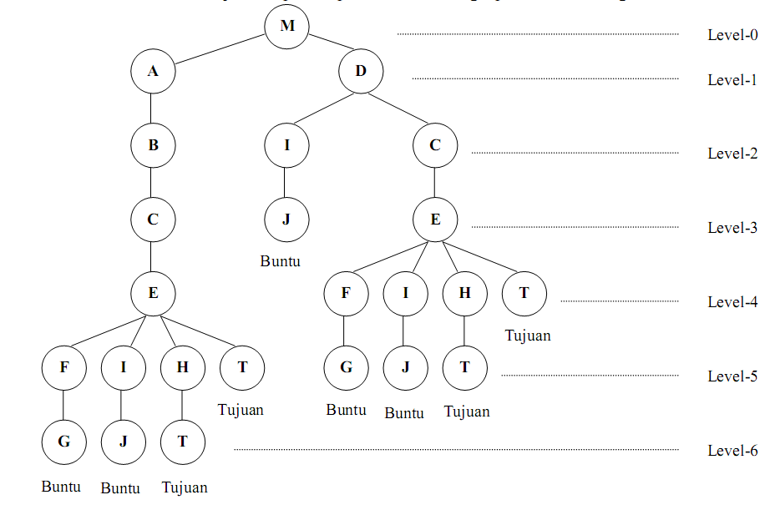
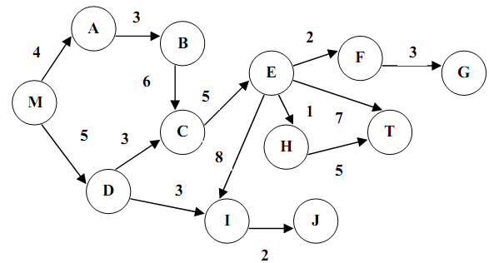
REPRESENTASI RUANG KEADAAN/MASALAH
Graph
Tree
Jika Node awal=M dan tujuan=T, ada berapa kemungkinan jalur yang dapat ditempuh?
M-A-B-C-E-T; M-A-B-C-E-H-T; M-D-C-E-H-T; M-D-C-E-T

Slide 11
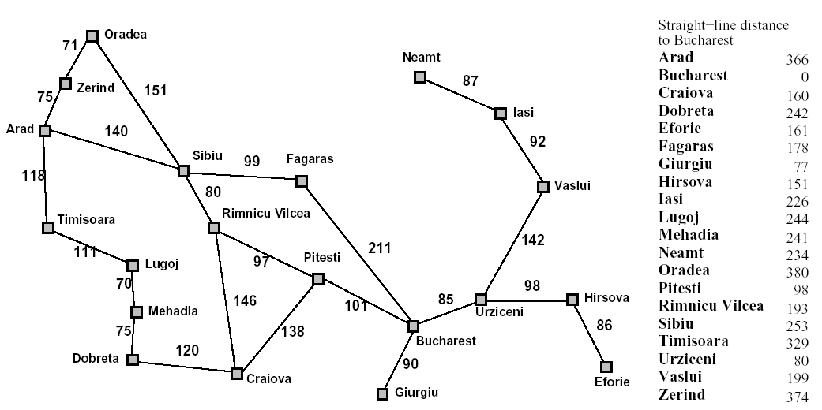
UNIFORM COST SEARCH
Romanian Route Finding
Start
End
What’s the real shortest path from Arad to Bucharest?
What’s the distance on that path?

Slide 12
UNIFORM COST SEARCH
Romanian Route Finding
Initial state = Arad
Best Path | Arad
Path cost | 0
Goal state? | No

Slide 13
UNIFORM COST SEARCH
Romanian Route Finding
Initial state = Arad
Arad – Zerind : 75
Arad – Sibiu : 140
Arad – Timisoara: 118
1
Best Path | Arad-Zerind
Path cost | 75
Goal state? | No

Slide 14
UNIFORM COST SEARCH
Romanian Route Finding
Initial state = Arad
Arad – Zerind = 75
Arad – Sibiu = 140
Arad – Timisoara = 118
Arad – Zerind – Oradea = 146
Arad – Sibiu = 140
Arad – Timisoara = 118
2
Best Path | Arad-Timisoara
Path cost | 118
Goal state? | No

Slide 15
UNIFORM COST SEARCH
Romanian Route Finding
Initial state = Arad
Arad – Zerind = 75
Arad – Sibiu = 140
Arad – Timisoara = 118
Arad – Zerind – Oradea = 146
Arad – Sibiu = 140
Arad – Timisoara = 118
Arad – Zerind – Oradea = 146
Arad – Sibiu = 140
Arad – Timisoara – Lugoj = 229
3
Best Path | Arad-Sibiu
Path cost | 140
Goal state? | No

Slide 16
UNIFORM COST SEARCH
Romanian Route Finding
Initial state = Arad
Arad – Zerind = 75
Arad – Sibiu = 140
Arad – Timisoara = 118
Arad – Zerind – Oradea = 146
Arad – Sibiu = 140
Arad – Timisoara = 118
Arad – Zerind – Oradea = 146
Arad – Sibiu = 140
Arad – Timisoara – Lugoj = 229
Arad – Zerind – Oradea = 146
Arad – Sibiu – Fagaras = 239
Arad – Sibiu – Rimnicu Vilcea = 220
Arad – Timisoara – Lugoj = 229
4
Best Path | Arad-Zerind-Oradea
Path cost | 146
Goal state? | No

Slide 17
UNIFORM COST SEARCH
Romanian Route Finding
Arad – Zerind – Oradea – Sibiu = 297
Arad – Sibiu – Fagaras = 239
Arad – Sibiu – Rimnicu Vilcea = 220
Arad – Timisoara – Lugoj = 229
5
Best Path | Arad-Sibiu-Rimnicu Vilcea
Path cost | 220
Goal state? | No

Slide 18
UNIFORM COST SEARCH
Romanian Route Finding
Arad – Zerind – Oradea – Sibiu = 297
Arad – Sibiu – Fagaras = 239
Arad – Sibiu – Rimnicu Vilcea = 220
Arad – Timisoara – Lugoj = 229
Arad – Zerind – Oradea – Sibiu = 297
Arad – Sibiu – Fagaras = 239
Arad – Sibiu – Rimnicu Vilcea – Pitesti = 317
Arad – Sibiu – Rimnicu Vilcea – Craiova = 366
Arad – Timisoara – Lugoj = 229
6
Best Path | Arad-Sibiu-Lugoj
Path cost | 229
Goal state? | No

Slide 19
UNIFORM COST SEARCH
Romanian Route Finding
Arad – Zerind – Oradea – Sibiu = 297
Arad – Sibiu – Fagaras = 239
Arad – Sibiu – Rimnicu Vilcea = 220
Arad – Timisoara – Lugoj = 229
Arad – Zerind – Oradea – Sibiu = 297
Arad – Sibiu – Fagaras = 239
Arad – Sibiu – Rimnicu Vilcea – Pitesti = 317
Arad – Sibiu – Rimnicu Vilcea – Craiova = 366
Arad – Timisoara – Lugoj = 229
Arad – Zerind – Oradea – Sibiu = 297
Arad – Sibiu – Fagaras = 239
Arad – Sibiu – Rimnicu Vilcea – Pitesti = 317
Arad – Sibiu – Rimnicu Vilcea – Craiova = 366
Arad – Timisoara – Lugoj – Mehadia = 299
Best Path | Arad-Sibiu-Fagaras
Path cost | 239
Goal state? | No
7

Slide 20
UNIFORM COST SEARCH
Romanian Route Finding
Arad – Zerind – Oradea – Sibiu = 297
Arad – Sibiu – Fagaras – Bucharest = 450
Arad – Sibiu – Rimnicu Vilcea – Pitesti = 317
Arad – Sibiu – Rimnicu Vilcea – Craiova = 366
Arad – Timisoara – Lugoj – Mehadia = 299
8
Best Path | Arad-Zerind-Oradea-Sibiu
Path cost | 297
Goal state? | No
Sudah mencapai tujuan (Bucharest), apakah pencarian dapat dihentikan?

Slide 21
UNIFORM COST SEARCH
Romanian Route Finding
Arad – Zerind – Oradea – Sibiu – Fagaras = 396
Arad – Zerind – Oradea – Sibiu – Rimnicu Vilcea = 377
Arad – Sibiu – Fagaras – Bucharest = 450
Arad – Sibiu – Rimnicu Vilcea – Pitesti = 317
Arad – Sibiu – Rimnicu Vilcea – Craiova = 366
Arad – Timisoara – Lugoj – Mehadia = 299
9
Best Path | Arad-Timisoara-Lugoj-Mehadia
Path cost | 299
Goal state? | No

Slide 22
UNIFORM COST SEARCH
Romanian Route Finding
Arad – Zerind – Oradea – Sibiu – Fagaras = 396
Arad – Zerind – Oradea – Sibiu – Rimnicu Vilcea = 377
Arad – Sibiu – Fagaras – Bucharest = 450
Arad – Sibiu – Rimnicu Vilcea – Pitesti = 317
Arad – Sibiu – Rimnicu Vilcea – Craiova = 366
Arad – Timisoara – Lugoj – Mehadia – Dobreta = 374
10
Best Path | Arad – Sibiu – Rimnicu Vilcea – Pitesti
Path cost | 317
Goal state? | No

Slide 23
UNIFORM COST SEARCH
Romanian Route Finding
Arad – Zerind – Oradea – Sibiu – Fagaras = 396
Arad – Zerind – Oradea – Sibiu – Rimnicu Vilcea = 377
Arad – Sibiu – Fagaras – Bucharest = 450
Arad – Sibiu – Rimnicu Vilcea – Pitesti - Crainova = 455
Arad – Sibiu – Rimnicu Vilcea – Pitesti - Bucharest = 418
Arad – Sibiu – Rimnicu Vilcea – Craiova = 366
Arad – Timisoara – Lugoj – Mehadia – Dobreta = 374
11
Best Path | Arad – Sibiu – Rimnicu Vilcea – Craiova
Path cost | 366
Goal state? | No

Slide 24
UNIFORM COST SEARCH
Romanian Route Finding
Arad – Zerind – Oradea – Sibiu – Fagaras = 396
Arad – Zerind – Oradea – Sibiu – Rimnicu Vilcea = 377
Arad – Sibiu – Fagaras – Bucharest = 450
Arad – Sibiu – Rimnicu Vilcea – Pitesti - Crainova = 455
Arad – Sibiu – Rimnicu Vilcea – Pitesti - Bucharest = 418
Arad – Sibiu – Rimnicu Vilcea – Craiova – Pitesti = 504
Arad – Sibiu – Rimnicu Vilcea – Craiova – Dobreta = 486
Arad – Timisoara – Lugoj – Mehadia – Dobreta = 374
12
Best Path | Arad – Timisoara – Lugoj – Mehadia – Dobreta
Path cost | 374
Goal state? | No

Slide 25
UNIFORM COST SEARCH
Romanian Route Finding
Arad – Zerind – Oradea – Sibiu – Fagaras = 396
Arad – Zerind – Oradea – Sibiu – Rimnicu Vilcea = 377
Arad – Sibiu – Fagaras – Bucharest = 450
Arad – Sibiu – Rimnicu Vilcea – Pitesti - Crainova = 455
Arad – Sibiu – Rimnicu Vilcea – Pitesti - Bucharest = 418
Arad – Sibiu – Rimnicu Vilcea – Craiova – Pitesti = 504
Arad – Sibiu – Rimnicu Vilcea – Craiova – Dobreta = 486
Arad – Timisoara – Lugoj – Mehadia – Dobreta – Craiova = 494
13
Best Path | Arad – Zerind – Oradea – Sibiu – Rimnicu Vilcea
Path cost | 377
Goal state? | No

Slide 26
UNIFORM COST SEARCH
Romanian Route Finding
Arad – Zerind – Oradea – Sibiu – Fagaras = 396
Arad – Zerind – Oradea – Sibiu – Rimnicu Vilcea – Pitesti = 474
Arad – Zerind – Oradea – Sibiu – Rimnicu Vilcea – Craiova = 523
Arad – Sibiu – Fagaras – Bucharest = 450
Arad – Sibiu – Rimnicu Vilcea – Pitesti - Crainova = 455
Arad – Sibiu – Rimnicu Vilcea – Pitesti - Bucharest = 418
Arad – Sibiu – Rimnicu Vilcea – Craiova – Pitesti = 504
Arad – Sibiu – Rimnicu Vilcea – Craiova – Dobreta = 486
Arad – Timisoara – Lugoj – Mehadia – Dobreta – Craiova = 494
14
Best Path | Arad – Zerind – Oradea – Sibiu – Fagaras
Path cost | 396
Goal state? | No

Slide 27
UNIFORM COST SEARCH
Romanian Route Finding
Arad – Zerind – Oradea – Sibiu – Fagaras – Bucharest = 607
Arad – Zerind – Oradea – Sibiu – Rimnicu Vilcea – Pitesti = 474
Arad – Zerind – Oradea – Sibiu – Rimnicu Vilcea – Craiova = 523
Arad – Sibiu – Fagaras – Bucharest = 450
Arad – Sibiu – Rimnicu Vilcea – Pitesti - Crainova = 455
Arad – Sibiu – Rimnicu Vilcea – Pitesti - Bucharest = 418
Arad – Sibiu – Rimnicu Vilcea – Craiova – Pitesti = 504
Arad – Sibiu – Rimnicu Vilcea – Craiova – Dobreta = 486
Arad – Timisoara – Lugoj – Mehadia – Dobreta – Craiova = 494
15
Best Path | Arad – Sibiu – Rimnicu Vilcea – Pitesti - Bucharest
Path cost | 418
Goal state? | Yes

Slide 28
UNIFORM COST SEARCH
Apakah dapat menemukan tujuan / solusi? Ya
Berapa langkah? 15 langkah
Apakah optimal? Ya, dalam menemukan solusi
Bagaimana dengan waktu dan memory ? Lama/besar

Slide 29

let's take a coffee break

Slide 30
BEST FIRST SEARCH
Node yang dipilih berdasarkan evaluation function f(n), f(n) paling rendah akan dipilih
Fungsi heuristik h(n) adalah fungsi estimasi jarak terdekat antara node tertentu n dengan node tujuan.
Jika h(n) = 0 maka n adalah node tujuan
Greedy BFS → f(n) = h(n)
A* → f(n) = h(n) + g(n)

Slide 31
GREEDY BEST FIRST SEARCH
Romanian Route Finding
Start
End
What’s the real shortest path from Arad to Bucharest?
What’s the distance on that path?

Slide 32
GREEDY BEST FIRST SEARCH
Romanian Route Finding
Initial state = Arad
Best Path | Arad
Path cost | 0
Goal state? | No

Slide 33
GREEDY BEST FIRST SEARCH
Romanian Route Finding
Initial state = Arad
Arad – Zerind = 374
Arad – Sibiu = 253
Arad – Timisoara = 329
Best Path | Arad-Sibiu
Best Cost | 253
Goal state? | No

Slide 34
GREEDY BEST FIRST SEARCH
Romanian Route Finding
Initial state = Arad
Arad – Zerind = 374
Arad – Sibiu = 253
Arad – Timisoara = 329
Arad – Sibiu – Oradea = 380
Arad – Sibiu – Fagaras = 178
Arad – Sibiu – Rimnicu Vilcea = 193
Best Path | Arad – Sibiu – Fagaras
Best cost | 178
Goal state? | No

Slide 35
GREEDY BEST FIRST SEARCH
Romanian Route Finding
Initial state = Arad
Arad – Zerind = 374
Arad – Sibiu = 253
Arad – Timisoara = 329
Arad – Sibiu – Oradea = 380
Arad – Sibiu – Fagaras = 178
Arad – Sibiu – Rimnicu Vilcea = 193
Arad – Sibiu – Fagaras – Bucharest = 0
Sudah mencapai tujuan, tapi apakah jalur yang terpilih adalah terbaik?
Best Path | Arad – Sibiu – Fagaras – Bucharest
Best cost | 0
Goal state? | Yes

Slide 36
Greedy Best First Search
Complete ?
Tidak, bisa terjadi looping, mis: Oradea sebagai goal jika start dari lasi.
Time ?
O(b^{m}) namun dengan heuristic yang baik akan memberikan improvement yang besar
Space ?
O(b^{m}) Setiap node disimpan dalam memory
Optimal ?
Tidak, perhatikan kasus rute ke Bucharest sebelumnya

Slide 37
Algoritma A*
A* → f(n) = h(n) + g(n)
f(n) = fungsi biaya
h(n) = estimasi biaya untuk menuju ke tujuan
g(n) = biaya yang sudah ditempuh
Contoh:
Misalnya path Arad-Sibiu dengan tujuan=Bucharest
h(n) = 253
g(n) = 140
f(n) = h(n) + g(n) = 393

Slide 38
ALGORITMA A*
Romanian Route Finding
Initial state = Arad
Best Path | Arad
Path cost | 366
Goal state? | No

Slide 39
ALGORITMA A*
Romanian Route Finding
Initial state = Arad
Arad – Zerind = 75 + 374 = 449
Arad – Sibiu = 140 + 253 = 393
Arad – Timisoara = 118 + 329 = 447
Best Path | Arad-Sibiu
Path cost | 393
Goal state? | No

Slide 40
ALGORITMA A*
Romanian Route Finding
Initial state = Arad
Arad – Zerind = 75 + 374 = 449
Arad – Sibiu = 140 + 253 = 393
Arad – Timisoara = 118 + 329 = 447
Arad – Zerind = 75 + 374 = 449
Arad – Sibiu – Fagaras = 239 + 178 = 417
Arad – Sibiu – Rimnicu Vilcea = 220 + 193 = 413
Arad – Timisoara = 118 + 329 = 447
Best Path | Arad – Sibiu – Rimnicu Vilcea
Path cost | 413
Goal state? | No

Slide 41
ALGORITMA A*
Romanian Route Finding
Arad – Zerind = 75 + 374 = 449
Arad – Sibiu – Fagaras = 239 + 178 = 417
Arad – Sibiu – Rimnicu Vilcea – Pitesti = 317 + 98 = 415
Arad – Sibiu – Rimnicu Vilcea – Craiova = 366 + 160 = 526
Arad – Timisoara = 118 + 329 = 447
Best Path | Arad – Sibiu – Rimnicu Vilcea – Pitesti
Path cost | 415
Goal state? | No

Slide 42
ALGORITMA A*
Romanian Route Finding
Arad – Zerind = 75 + 374 = 449
Arad – Sibiu – Fagaras = 239 + 178 = 417
Arad – Sibiu – Rimnicu Vilcea – Pitesti - Bucharest = 418 + 0 = 418
Arad – Sibiu – Rimnicu Vilcea – Pitesti - Craiova = 455 + 160 = 615
Arad – Sibiu – Rimnicu Vilcea – Craiova = 366 + 160 = 526
Arad – Timisoara = 118 + 329 = 447
Best Path | Arad – Sibiu – Fagaras
Path cost | 417
Goal state? | No

Slide 43
ALGORITMA A*
Romanian Route Finding
Arad – Zerind = 75 + 374 = 449
Arad – Sibiu – Fagaras – Buchares = 450 + 0 = 450
Arad – Sibiu – Rimnicu Vilcea – Pitesti - Bucharest = 418 + 0 = 418
Arad – Sibiu – Rimnicu Vilcea – Pitesti - Craiova = 455 + 160 = 615
Arad – Sibiu – Rimnicu Vilcea – Craiova = 366 + 160 = 526
Arad – Timisoara = 118 + 329 = 447
Algoritma A* dapat menemukan tujuan lebih cepat dibanding Uniform Cost Search dan Greedy BFS
Best Path | Arad – Sibiu – Rimnicu Vilcea – Pitesti – Bucharest
Path cost | 418
Goal state? | Yes

Slide 44
ALGORITMA A*
Complete ?
Ya, selalu menemukan solusi jika solusinya ada.
Time ?
Eksponensial
Space ?
O(b^{m}) Setiap node disimpan dalam memory
Optimal ?
Ya

Slide 45
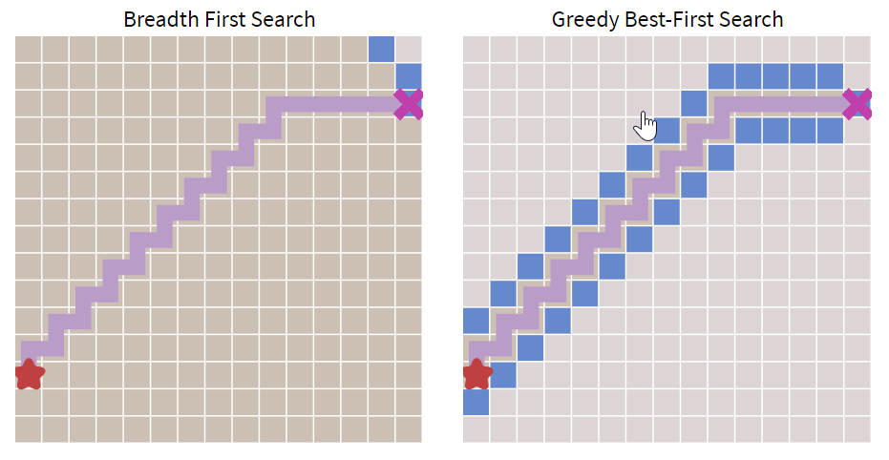
BREADTH FIRST SEARCH vs GREEDY BEST FIRST SEARCH
https://cs.stanford.edu/people/abisee/tutorial/greedy.html

Slide 46
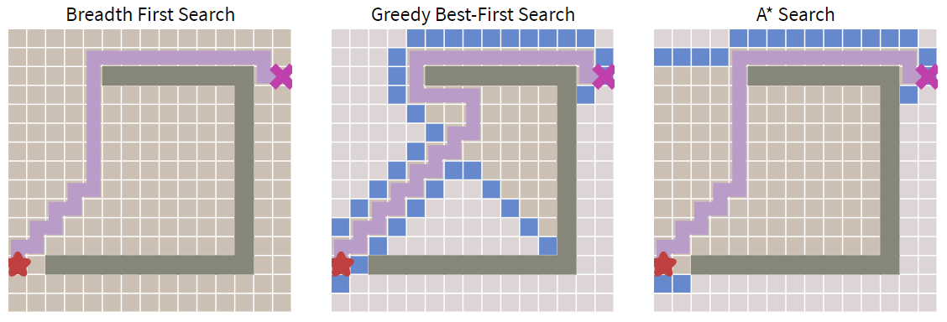
BFS VS GREEDY BFS VS A*
https://cs.stanford.edu/people/abisee/tutorial/astar.html

Slide 47
The 8-Puzzle Problem
CONTOH
1
2
3
Permasalahan 8-puzzle adalah sebuah puzzle yang ditemukan dan dipopulerkan oleh Noyes Palmer Chapman pada tahun 1870. Puzzle dimainkan dalam bentuk kotak 3x3 dengan 8 kotak yang diisi angka 1 sampai 8, serta sebuah kotak kosong.
Tugas pemain adalah menyusun kotak-kotak tersebut dalam urutan yang benar. Pemain dapat menggeser kotak yang kosong ke atas, ke bawah, ke kiri dan ke kanan.
7
8
4
awal
6
5
1
2
3
8
4
tujuan
7
6
5

Slide 48
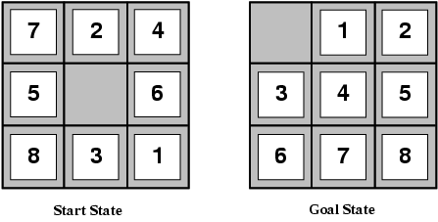
FUNGSI HEURISTIK PADA 8-Puzzle PROBLEM
Contoh pada 8-puzzles, diusulkan 2 h(n)
h1 = Jumlah kotak yang salah penempatan
h2 = Manhatan distance → jumlah dari jarak masing-masing kotak ke tujuan, dengan aturan tidak bisa bergerak secara diagonal
h1 = 8
h2 = 3 + 1 + 2 + 2 + 2 + 3 + 3 + 2
= 18
Dari kedua fungsi heuristic tersebut
sudah sama-sama tidak overestimate
(solusi sebenarnya = 26 step)

Slide 49
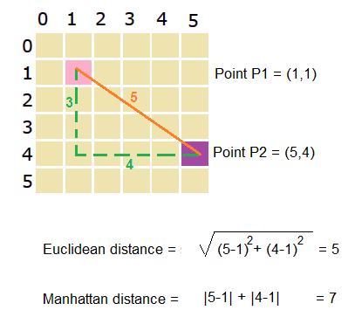
MANHATAN DISTANCE VS EUCLIDEAN DISTANCE

Slide 50


BAGAIMANA MENYELESAIKAN 8-PUZZLE?
https://youtu.be/QXFfnWrlkC8

Slide 51
LATIHAN MANDIRI: ALGORITMA A*
h(n) = Jumlah kotak yang salah penempatan
g(n) = manhatan distance
2 | 4 | 3
1 | 7 | 5
6 |  | 8
1 | 2 | 3
4 |  | 5
6 | 7 | 8
Initial State
Goal State

Slide 52
REFERENSI
Russel, S., & Norvig, P. (2003). Artificial Intelligence A Modern Approach . New Jersey : Pearson Education, Inc.
Suyanto. (2011). Artificial Intelligence . Bandung : Informatika .
Sutojo, T., Mulyanto, E., & Suhartono, V. (2011). Kecerdasan Buatan . Yogyakarta : C.V.Andi Offset.
https://cs.stanford.edu/people/abisee/gs.pdf
Slide “Informed (Heuristic) Search” from Washington Edu https://courses.cs.washington.edu/courses/cse473/09au/schedule/InformedSearch2009.ppt

Slide 53


Kesimpulan
SELESAI

